Slide 1

Exploring the integration of genomic data into stochastic modeling of Cell Cycle
MASTER'S DEGREE IN QUANTITATIVE AND COMPUTATIONAL BIOLOGY
Supervisor: Prof. Alessandro Romanel (PhD) Graduant: Andrea Tonina

Slide 2
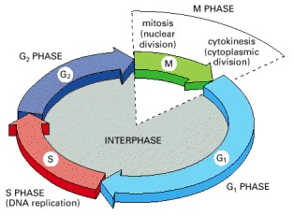
Cell cycle
Alberts B, Johnson A, Lewis J, et al. Molecular Biology of the Cell. 4th edition. New York: Garland Science; 2002. An Overview of the Cell Cycle.
Notes:
The ‬‭term ‬‭cell‬ ‭cycle ‬‭refers ‬‭to ‬‭the ‬‭various ‬‭events ‬‭that ‬‭take‬ ‭place ‬‭in‬ ‭a ‬‭cell which enables ‬‭duplication ‬‭of cell ‭contents‬ ‭and‬ ‭generating‬ ‭two‬ ‭genetically ‬‭identical ‬‭daughter ‬‭cells ‬‭by ‬‭segregation‭.‬ ‬‭‬
‭The‬ ‭cell‬ ‭cycle‬ ‭is‬ ‭composed‬ ‭of‬ ‭two‬ ‭basic‬ ‭parts:‬ ‭Mitosis‬ ‭and‬ ‭Interphase.‬ ‭During ‬‭Interphase,‬‭‬‭cells ‬‭typically ‭doubles‬ ‭in‬ ‭size ‬‭with ‬‭a ‬‭consistent‬‭ rate‬‭ -> can be subdivided into 3 phases:‬
‭- phase‬ ‭G1,‬ ‭where‬ ‭the‬ ‭cell‬ ‭prepares‬ ‭for‬ ‭DNA‬ ‭synthesis
- ‭phase‬ ‭S,‬ ‭where‬ ‭DNA‬ ‭replication‬ ‭takes‬ ‭place‬ ‭and‬
- phase G2, when the cell prepares for the mitotic event‬‭‬‭.‬
‭The‬ ‭mitotic‬ ‭phase‬ ‭(M)‬ ‭encompasses‬ ‭cell‬ ‭division‬ ‭and‬ ‭usually‬ ‭the‬ ‭subsequent‬ ‭Cytokinesis‬ ‭(cytoplasmic‬ ‭division)‬‭.‬ ‬
ciclo cellualre si compone di fasi

Slide 3
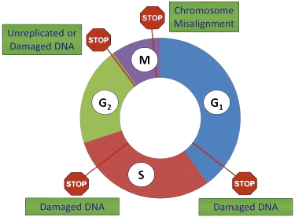
Cell cycle regulations
Cyclin-CDK complexes
‭Transcriptional‬‭ control
Protein-protein‬ interactions‬ ‭and‬ ‭subcellular‬ ‭localization
Cell cycle checkpoints
Vincent W. Yang, Chapter 15 - The Cell Cycle, Editor(s): Leonard R. Johnson, Fayez K. Ghishan, Jonathan D. Kaunitz, Juanita L. Merchant,
Hamid M. Said, Jackie D. Wood, Physiology of the Gastrointestinal Tract (Fifth Edition), Academic Press, 2012, Pages 451-471.
Notes:
the cell cycle is regulated by a complex newtowork which determ if the cell cycle can proceed to the next phase, various actor are present for these control like:
‬- ‭most‬ ‭notably‬ ‭the‬ ‭cyclins‬ ‭and‬ ‭Cyclin-dependent ‬‭kinases‬‭(CDKs) ‬‭functional ‬‭unit‬ ‭that‬‭ drives ‬‭cell ‬‭cycle ‬‭progression ‬‭by ‬‭phosphorylating ‬‭a ‬‭variety‬ ‭of target ‬‭proteins
-transcriptional ‬‭control that regulate the ‭level‬ ‭of‬ ‭genes‬ ‭encoding‬ ‭various cell ‬‭cycle‬ ‭regulators
- ‭protein-protein‬ ‭interactions‬ ‭and‬ ‭subcellular‬ ‭localization‬ ‭play‬ ‭crucial‬ ‭roles‬ ‭in‬ ‭modulating‬ ‭phase‬ ‭transitions
-‭ Checkpoints‬ ‭monitor‬ ‭critical‬ ‭events‬ ‭and‬ ‭trigger‬ ‭appropriate‬ ‭cellular‬ ‭responses‬ ‭based‬ ‭on‬ ‭the‬ ‭situations,‬ ‭ranging‬ ‭from‬ ‭cell‬ ‭cycle‬ ‭arrest‬ ‭and‬ ‭DNA‬ ‭repair‬‭ to ‬‭apoptosis

Slide 4
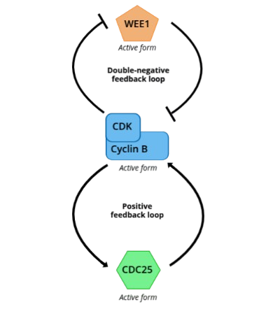
Cell cycle transitions
Biological switches
G2 ⇨ M
Stochastic or Deterministic approaches
Adapted from Zámborszky, J. (2013). Cell Cycle Transitions, G2/M. In: Dubitzky, W., Wolkenhauer, O., Cho, KH., Yokota, H. (eds) Encyclopedia of Systems Biology. Springer, New York, NY. https://doi.org/10.1007/978-1-4419-9863-7_38
Notes:
These process like cell cycle can be described as biological switches, which are studied in system biology.
Well studied‬‭ example ‬‭of ‬‭biological ‬‭switches‬‭ is ‬‭the ‬‭transition ‬‭from‬ ‭interphase ‬‭to ‬‭mitosis‬‭(G2‬‭⇨‬‭M) ‬‭in ‬‭the ‭cell‬ ‭cycle,‬ ‭based‬ on ‬‭the ‬‭activity ‬‭of ‬‭the ‬‭mitotic‬‭ cyclin-dependent‬‭ kinase ‬‭complex. In context of this transition two positive feedback loops are present, for cdc25 pure positive whereas for Wee1 is a double negative feedback loops
These biological switches can be described by usign mathematical modeling, specifically with demterministicl model which doesn't involve random variable and reproduce the same resulti each time with identical parameter values,
whereas stomcastich model which can describe scenarios that are more subject to noise
aspetto probabilsitica che permetter di desctivere scenrai pi\ soggetti a rumore

Slide 5
Genetic variability
Difference‬ ‭in‬ ‭DNA‬ ‭sequences‬ ‭within‬ ‭our‬ ‭genomes‬‭ among‬ ‭individuals
Mutations‬ ‭are‬ ‭the‬ ‭ultimate‬ ‭source‬ ‭of‬ ‭new‬ ‭genetic‬ ‭variants ‬‭in ‬‭DNA
‬‭Spectrum‬ mutation ‬‭is ‬‭quite ‬‭broad‬ ‭and ‬‭diverse
Distinction between : germline or somatic
Notes:
these processes like cell cycle can be impacted from various factors, like genetic vaaiblity which is difference‬ ‭in‬ ‭DNA‬ ‭sequences‬ ‭within‬ ‭our‬ ‭genomes‬‭ among‬ ‭individuals‬‭.
‬‭. ‭ Mutations‬ ‭are‬ ‭the‬ ‭ultimate‬ ‭source‬ ‭of‬ ‭new‬ ‭genetic‬ ‭variants ‬‭in ‬‭DNA,‬‭which‬‭ are ‬‭permanent‬‭ alterations ‬‭in ‬‭the‬ ‭DNA‬ ‭sequence‬‭‬‭.‬ ‭These‬ ‭changes‬ ‭can‬ ‭occur‬ ‭spontaneously‬ ‭due‬ ‭to‬ errors‬‭ in‬‭ DNA‬‭ replication ‬‭or ‬‭be‬ ‭induced by environmental factors, known as mutagens.
The ‬‭spectrum‬ ‭of ‬‭mutation ‬‭is ‬‭quite ‬‭broad‬ ‭and ‬‭diverse. ‬‭Indeed,‬‭ it ‬‭can ‬‭range ‬‭from‬ ‭changes ‬‭in ‬‭a‬ ‭single‬ ‭DNA‬‭ base ‬to‬ ‭a‬ ‭large-scale‬ ‭chromosomal‬ ‭rearrangements.
Moreover we can distinguish mutations in germline, so ‭heritable meaning‬ ‭capable‬ ‭of ‬‭passing ‬‭down‬ ‭to ‭offspring, or somatic‬‭, which can ‬‭arise ‬‭during‬‭ an‬‭ individual’s‬‭ lifetime ‬‭in ‬‭any ‬‭cell ‬‭of ‬‭the ‬‭body‬ ‭except ‬‭germ‬ ‭cells.
This ‬‭variability can‬ influence‬ ‭our‬ predisposition ‭to‬‭ a ‬‭wide‬‭ range‬‭ of ‬‭diseases

Slide 6
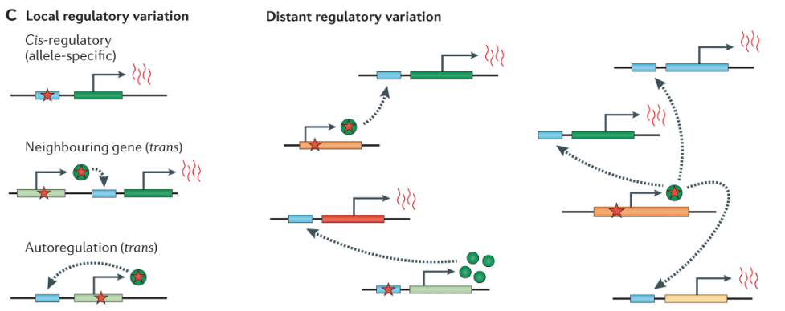
eQTLs
Albert, F., Kruglyak, L. The role of regulatory variation in complex traits and disease. Nat Rev Genet 16, 197–212 (2015). https://doi.org/10.1038/nrg3891
Notes:
As germline mutations we focus on
‭Expression‬ ‭quantitative‬ ‭trait‬ ‭loci‬ ‭(eQTLs)‬ ‭are‬ ‭genomic‬ ‭regions‬ ‭that‬ ‭contain‬ ‭one‬ ‭or‬ ‭more‬ ‭variants‬ ‭that‬ ‭influence‬ ‭the‬ ‭expression‬ ‭level‬ ‭of‬ target ‭gene.
They are usually classified based on the physical distance from the gene they regulate and also base on the mechanism utilize to influence the gene expression of the target gene: cis if affect expression in an allele specific mananer or trans if impacting diffusible factor
_____
‬‭eQTLs‬ ‭are‬ ‭often‬ ‭classified‬ ‭according‬ ‭to‬ ‭their‬ ‭locations‬ ‭relative‬ ‭to‬ ‭the‬ ‭genes‬ ‭they‬ ‭influence‬ ‭and‬ ‭the‬ ‭mechanism‬ ‭through‬ ‭which‬ ‭expression‬ ‭is‬ ‭affected. Studies‬ ‭have‬ ‭characterized‬ ‭these‬ ‭regulatory‬ ‭variants‬ ‭as‬ ‭local‬ ‭or‬ ‭distant‬ ‭based‬ ‭on‬ ‭the ‬‭physical‬‭ distance‬‭ from ‬‭the‬‭ gene ‬‭they‬‭ regulate,‬‭ indeed ‬‭variants ‬‭within‬‭ 1Mb ‬‭on
‭either‬ ‭side‬ ‭of‬‭ the ‬‭transcription ‬‭start‬ ‭site ‬‭of ‬‭the‬ ‭gene‬ ‭are‬‭ classified ‬‭as ‬‭local,‬‭whereas‬ ‭those ‬‭with‬ ‭at‬‭least ‬‭5Mb‬ ‭downstream‬ ‭or‬ ‭upstream‬‭ or ‬‭even on ‬‭a ‬‭completely ‬‭different ‬‭chromosome ‬‭are ‬‭classified ‬‭as‬‭ distant‬‭e QTLs‬‭ in‬ ‭humans.
Influence‬ ‭gene‬ ‭expression‬ ‭by‬ ‭two‬ ‭different‬ ‭mechanism: cis‬ ‭and‬ ‭affect‬ ‭expression‬ ‭in‬ ‭an‬ ‭allele-specific‬ ‭manner‭, ‭trans-eQTLs‬ ‭are‬ ‭a‬ ‭result‬ ‭of‬ ‭polymorphisms‬ ‭that‬‭change‬‭the‬‭structure,‬‭function‬‭or‬‭expression‬‭of‬‭a‬‭proximal‬
‭diffusible‬ ‭factor‬ ‭like‬ ‭transcription‬ ‭factor,‬ ‭RNA-binding,‬ ‭signal‬ ‭factor,‬ ‭chromatin‬ ‭modifier‬ ‭or‬ ‭possible‬ ‭non-coding‬ ‭RNA.
questi processi osno impattati da diversi fattori, tra cui la varaiblit’ genetica. Introdurre slide varaiblita’ genetica /> differenze che ereditate almenio 1% popolazione e somatiche che possono portare varaiblit’ cancro
Varaibli germinali tra le varie sono eqtls che hano impatto su trascrizione > trans medaito da altre proteine

Slide 7
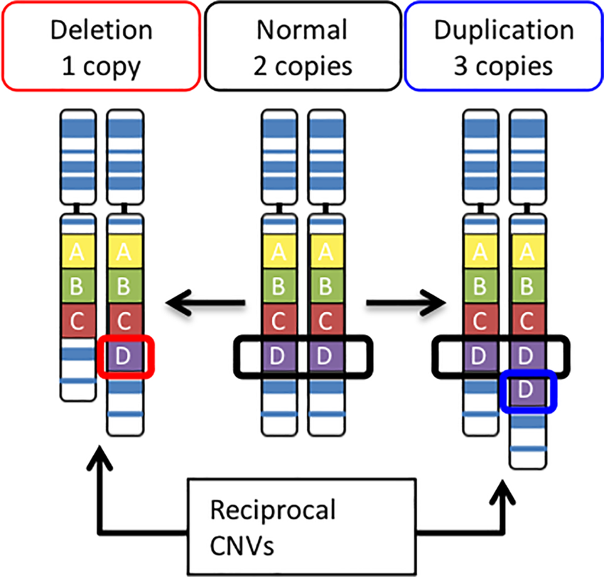
SCNA
SCNAs
Sønderby IE, Ching CRK, Thomopoulos SI, et al. Effects of copy number variations on brain structure and risk for psychiatric illness: Large-scale studies from the ENIGMA working groups on CNVs. Hum Brain Mapp. 2022; 43: 300–328
Notes:
For somatic mutations in this project we focused on Somatic Copy‬‭ number‬‭ aberration (CNVs) ‬‭which are ‭larger-scale changes of DNA regions‬ ‭spanning‬ ‭‭thousands‬ ‭to‬ ‭millions‬ ‭of‬ ‭bases‬ ‭and‬ ‭even‬ ‭entire‬ ‭genes wihtin somatic cells‬‭‬‭. This ‭mutation‬ ‭can‬ ‭alter‬ ‭gene‬ ‭dosage and ‭influence the amount of protein produced and contribute to phenotypic changes and disease susceptibility‭.
This mutation types are frequently observed in the majority of cancer types
___________________________
. These alterations can affect the expression and function of oncogenes and tumor suppressor genes, driving cancer development and progression.
Breast cancer is a prime example of a heterogeneous disease, and SCNAs are recognized as playing a crucial role in shaping this complexity . The well-established intertumor heterogeneity in breast cancer is, in part, defined by distinct patterns of SCNAs that characterize the various subtypes
varaibli molt oimpraotnti in tumorei.
quindi per varaibli germinali focalizaimo su eqtls e somatichescna

Slide 8
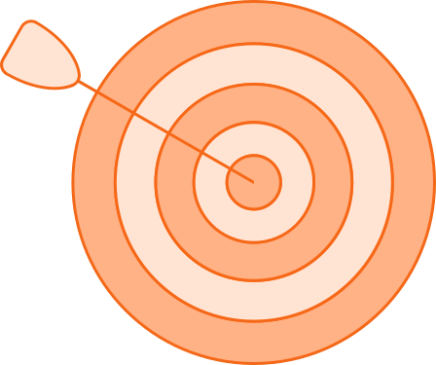
Aims
Characterization of a generic stochastic model of cell cycle transition
Human-specific cell cycle transition model G2/M
Explore the impact of germline and somatic variants
eQTLs
Somatic copy number alterations in breast cancer
Explore how this variants can be utilized to stratify patient in a tumoral context
Notes:
Leggi il resto e and explore how this variant can be utilized to stratify patient in a tumoral context
focalizzrarmi su un modello human spcefici, imaptto varaitni germoniali e somatiche, esplorare come queste varainti possono esser eutilizzate per stratificare pazienti nel contesto cancer
seguire andametno aim /> modello disponilie n leterature /

Slide 9
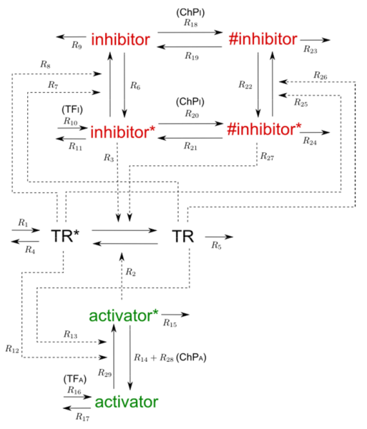
General and universal cell cycle transition model‬
Utilized for implementation of the model the stochastic programming language Blenx
Dematté, L., Priami, C., Romanel, A. (2008). The BlenX Language: A Tutorial. In: Bernardo, M., Degano, P., Zavattaro, G. (eds) Formal Methods for Computational Systems Biology. SFM 2008. Lecture Notes in Computer Science, vol 5016. Springer, Berlin, Heidelberg. https://doi.org/10.1007/978-3-540-68894-5_9
Romanel A, Jensen LJ, Cardelli L, Csikász-Nagy A (2012) Transcriptional Regulation Is a Major Controller of Cell Cycle Transition Dynamics. PLoS ONE 7(1): e29716. https://doi.org/10.1371/journal.pone.0029716
Notes:
From the literature we retrieve this general and universal cell cycle transition model for the eukaryotes, which is characterized by an activator, an inhibitor, a transition regulator protein. Also three layer of control notwork are described in the model : ‭transcriptional‬ ‭control,‬ ‭post-transcriptional‬ ‭positive‬ ‭feedback‬ ‭and‬ ‭checkpoint‬ ‭activation which impact the activity of inhibitor and activator.
—-----------------------
From the theory of Paul nurse the g2/m transition in universal in eukariotes and other studies suggesting also that other transitions of cell cycle in eukariotes presence of some part of univerislity, this model is based on that the university fo the cell transition in eukaryotes. ‭general‬ ‭cell‬ ‭cycle‬ ‭transition‬ ‭model‬ ‭is‬ ‭characterized‬ ‭by‬ ‭an‬ ‭activator‬ ‭and‬ ‭an‬ ‭inhibitor,‬ ‭which‬ ‭jointly‬ ‭regulate‬ ‭the‬ ‭activity‬ ‭of‬‭ a ‬‭transition ‬‭regulator ‬‭protein. Other aspect describe of the control network of the transitions are : Positive feedback loops of the transition protein of inhibitor and activator, transcriptional control though transcirptional factor that regualkte the transcription of activator and inhibitor, finally the checkpoin mechanism tha also impact, differently, the activator and inhibitor. Also there are some species that are not described in the model but are present in the reactions of the model, E1 and E2 which are kinases and Pho as phospatases, also S that ‬‭represents ‬‭a‬ ‭constitutive ‬‭signal ‬‭that‬ ‭activates ‭activator ‬‭when‬ ‭positive ‬‭feedback ‬‭on ‬‭the ‬‭activator ‬‭is ‬‭absent.
/> descrivere in modo sintetico il modello, utilizzato linguaggio descrittiv (blenx una frase)

Slide 10
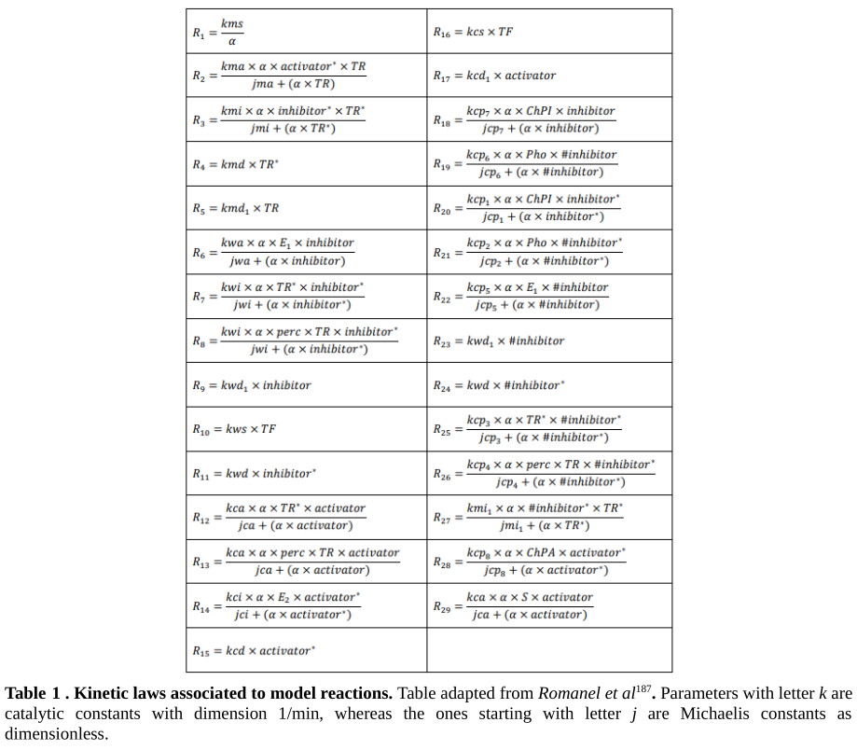

Slide 11
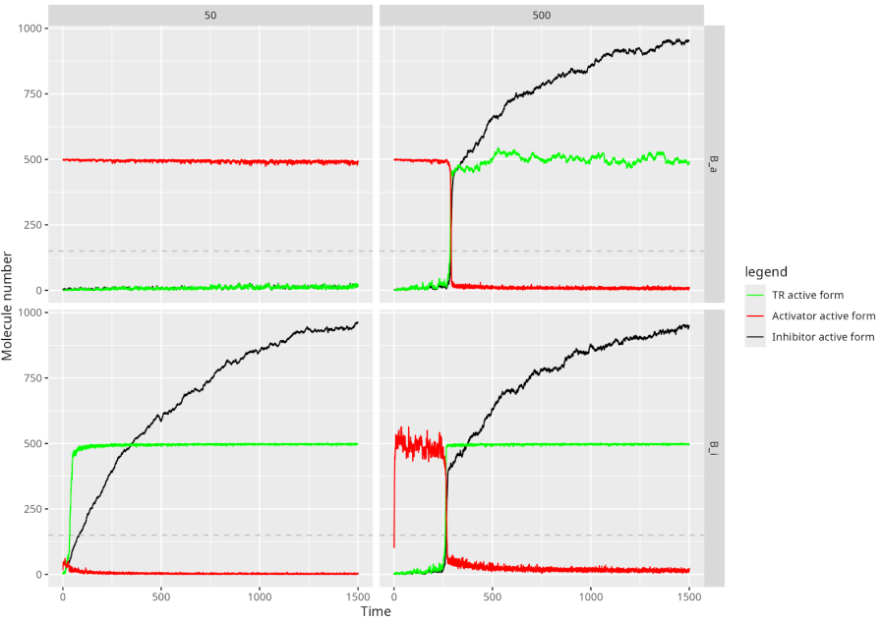
Simulations of GO and STOP transcriptional regulations‬
A total of 24 models were build using combination of the three regulatory processes
Notes:
To see if the models follows expected dynamic we created 24 computational model to observe the combinatory effect of the three regulatory processes of the model. It is possible to observe that by looking at the plots describing the switch time of the models tath they can be grouped in two grupes depending on the transcriptional control. If the activator is periodically trancibed and the inhibitor quantity ar constant then the system is called STOP, which it is possible to observe that with a tenth of normal quantity of the Trasncirpiotn factor the switch dosen happen, whereas if the inhibitor is periodically trasnciberd and the activator quantity is constant the switch happens even when changing the trascriptional factor quantity on the model and this system is called ‘GO’.
Seems that STOP system are present in transition that could impact teh vitality of teh cells whereas GO system is present in transition that not results much important for teh cell.
-> text built 24 models
This results confirm the dynamic we were expecting
—-----------------------------------
A series of computational models wre created for exploring the combinatory effect of the three key regulatory processes: transcritpional control, post transcriptional postive feedback and checkpoint activation. With the creation of overall 24 models from the original cell cycel model. It was possible to distinguish betwee two transcirptional control system these model, system ‘STOP’ which are the model that present periodical transcription on the activator and with static quantity of inhibitor whereas system ‘GO’ in whci the periodical transcription is related with the inhibitor and constat quantity of activator, It is possible to observed that the two models works in cases where the TF is reduced to a tenth from its normal quantity. This confirms the results obtained from teh paper it was retrieved the model, in which they suggested this difference is because probably STOP system is applied to transition in cell ‬‭cycle ‬‭transitions ‬‭of ‬‭critical ‬‭importance ‬‭to ‬‭cellular ‬‭viability.
vedere se seguissero dinamica aspettata
abbiamo linguaggio descritivo che ci permetteno lo studio BLEnx -> validazioen dimanima cel modello in questa slide con presenza 2 systmi compatible con quelloo -> tempo switch molto impraten

Slide 12
Sensitivity analysis of the general model‬
Species :
E2 variations impact transition in each models
TF_{A} variations more impactful on models than TF_{I}
ChP_{A} variations on PFB on inhibitors or both
Parameters:
kma variations impact transition on all models
jci variations impact model with transcriptional control on the activator only
Romanel A, Jensen LJ, Cardelli L, Csikász-Nagy A (2012) Transcriptional Regulation Is a Major Controller of Cell Cycle Transition Dynamics. PLoS ONE 7(1): e29716. https://doi.org/10.1371/journal.pone.0029716
Notes:
A sensitivity analysis was also performed, modifying the initial quantities of species and parameters one at time and iterating the model 100 time each to observe the robsuten of the model. We measured the average switch time and switch probability for each variations. The model is robust however it was possible to observe some Species and parameters which the models are sensible to them.
Having this informations we wanted to observe how integrating information from germline and somatic mutation could impact its dynamics.
___________________________________________________
Was performed for each one of teh 24 models a sort of locol sensitivity analysis by varying both the quantity of initial species and the parameters of the reactions, for the species it was ranged from 0 to 2x the normal quantity whereas for the parameters ranged from 10% of the original value to 10x the original values. Leggi + As result ‭Jci‬‭,‬‭which ‬‭regulates‬ ‭the‬ ‭transition ‬‭from‬ ‭the‬ ‭active‬ ‭to‬ ‭the‬ ‭inactive‬ ‭form‬ ‭of‬ ‭the‬ ‭activator,‬ ‭appears‬ ‭to‬ ‭be‬ ‭particularly‬ ‭influential.
-> parte prima modificare quanittya e paremtri per vedere, poi questa abbimao trovato paramtri improtatni -> modello robusto ma varaizioni in apramtri e specie possono avere forte impatto modello -> descrivere cosa misuro
-> impatto su tempo di switch e probabilità chei modello switchaesse -> robusto ma senisbili a varazioni paramtri -> colelgare a livello germinali e somatico quindi per espolare la dimensione, abbiamo cercato di rendere il modello piu specifico

Slide 13
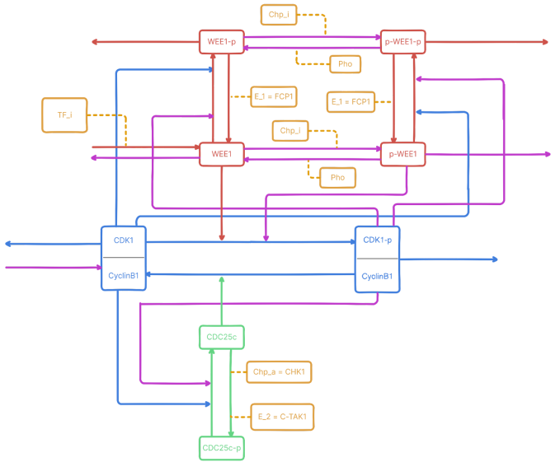
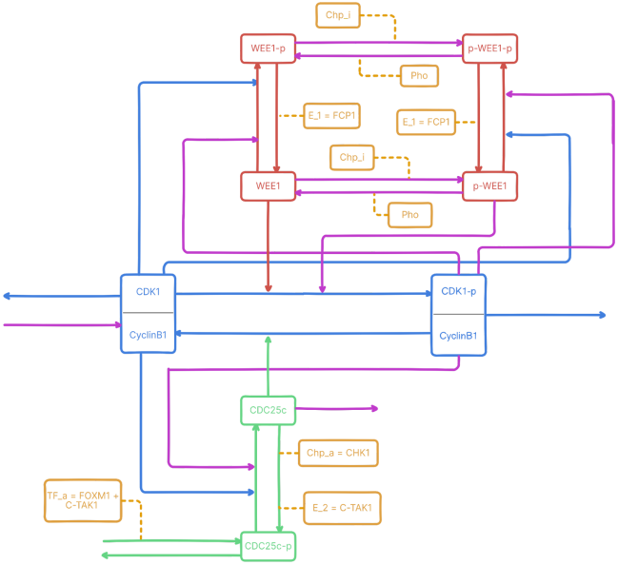
Human specific cell-cycle model G2/M‬
B_{I}^{B}
B_{A}^{B}
Notes:
Before that an extensive literature review was perform to adapt the general model into one more specific by finding the protagonists in human cell cycle, we focused specifically on G2/M. Some reactions, shown with purple arrows, were included as assumptions to ensure proper model function, as they lack direct support in human studies. Also because we didn’t found any information if wee1 or cdc25c are periodically transcribed then we create both the case studies.
—-------
The‬ ‭generic‬ ‭cell‬ ‭cycle‬ ‭transition‬ ‭model‬ ‭underwent‬ ‭adaptation‬ ‭to‬ ‭create‬ ‭a‬ ‭human-specific‬ ‭version‬ ‭of‬ ‭it‬ ‭as‬ ‭much‬ ‭as‬ ‭possible,‬ ‭correct‬ ‭and‬ ‭functional.‬ ‭The‬ ‭G2/M‬ ‭transition,‬ ‭known‬ ‭for‬ ‭its‬ ‭critical‬ ‭role‬ ‭in‬ ‭cancer‬ development ‬‭and ‬‭progression ‬‭when ‬‭malfunctioning, ‬‭was ‬‭chosen ‬‭as ‬‭the ‬‭reference ‬‭for ‬‭human ‬‭cell ‬‭cycle ‬‭model ‭adaptation. Key‬ ‭regulatory‬‭ components ‬‭include‬ ‭the‬ ‭Cdk1/cyclin‬‭B1‬‭ complex,‬ ‭Cdc25C‬ ‭phosphatase ‬‭and ‬‭Wee1‬ ‭kinase. Il resto a braccio. Also speigare le reazioni in purple. Anche il fatto che si e’ fatto due in quanto non si e’ trovata infomrazione specifica su cdc25c o wee1 be periodiucally transcribed
-> aggiugner con trascirptiona lregualtion su attivatro e inibitore.

Slide 14
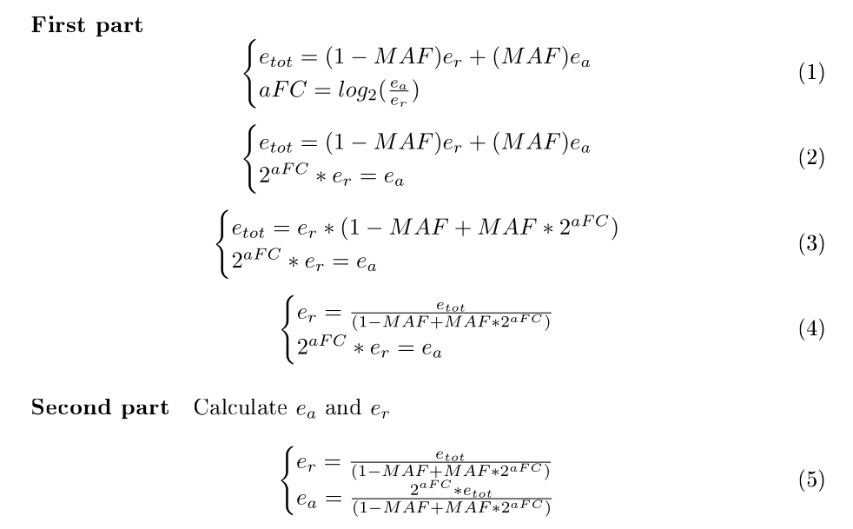

eQTLs
Adult Genotype-Tissue Expression (GTEx) project
median gene-levels expression in TPM for each tissue
eQTLs information for each gene of interest involved in the cell cycle G2/M transition
Notes:
‭For eqtls we utilze GTEx which is an online resource that containe extensive information about eqtls, with the informations we were able to retrieve and trough a mathematical formulation created by us we were able to obtain the expression of the allele reference and the alternative so with that we were able to have for each eqtls the expression range that is possible to observe in the population.
—------------------------
to ‬‭address ‬‭the ‬‭absence ‬‭of ‬‭information ‬‭on ‬‭genotype-specific ‬‭gene ‬‭expression ‬‭data it was utilized the median gene-level expression in TPm of various tissues of the eQTLs of interest and the information of allelic fold change of each eQTL of interest to create a system of equation. The formula utilized for allelic fold change was derived from GTEx and is where as the second one it has been hypotisezed that the median ex[pressioopn of each gene of interest coubl vbe approximate by conmsidering the expression of each allele, wieghted by the minor allele frequency. As result we were able to retrieve the expression of the reference and alternative allele, then this information was utilize to get the expression of the gene of interest in case of genotype homozygous reference, heterozygous and homzoygous alteratnive.

Slide 15
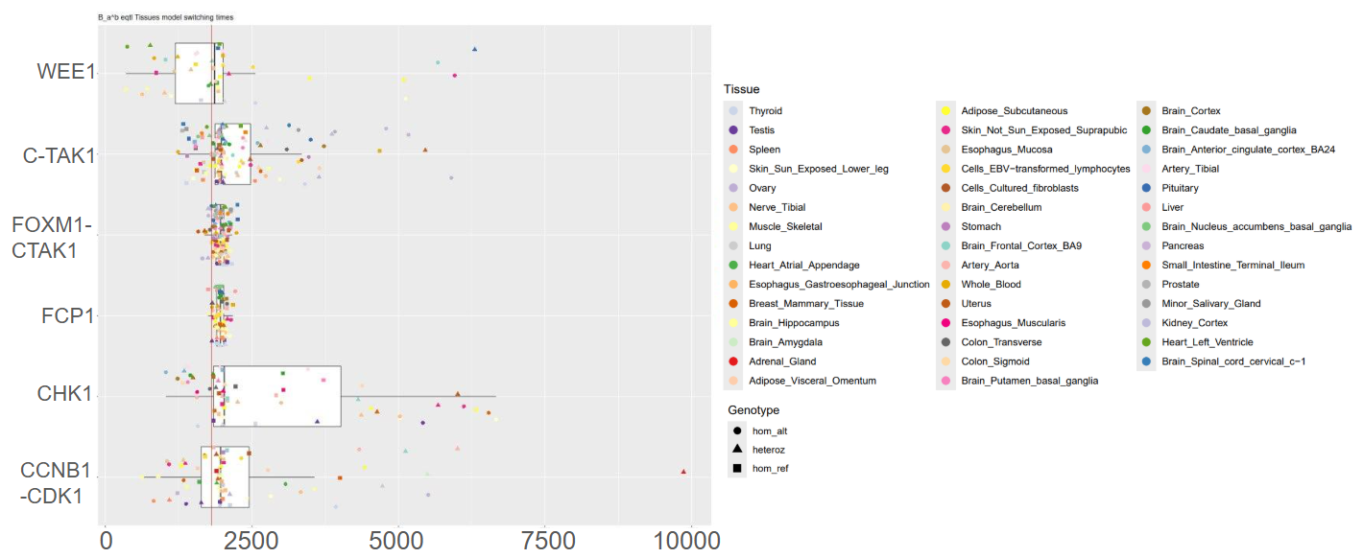
eQTLs
B_{A}^{B}
Notes:
The retrieved data were integrated into the model and here, the figure represent the results for the model with the activator under transcriptional control and constant inhibitor quantity. For each tissue, the information regarding the average switch time is present. Indeed, it is possible to observe that among the studied genes, WEE1, CTAK, CHK1 and CCNB1-CDK1 presented the highest variability. In certain cases, even causing the blockage of G2/M transition for our model. At the same time, there were cases, in which the presence of the eQTLs caused a quicker transition.
_________________________________
This‬ part of the study wanted to ‭examined‬ ‭the‬ ‭impact‬ ‭of‬ ‭eQTLs‬ ‭on‬ ‬‭gene that takes part in ‭cell ‬‭cycle ‬‭expression,‬‭specifically ‬‭in ‬‭heterozygous‬ ‭and‬ ‭homozygous‬ ‭alternative‬ ‭genotypes‬ ‭across‬ ‭various‬ ‭tissues,‬ ‭to‬ ‭determine‬ ‭if‬ ‭significant‬ ‭fluctuations‬ ‭occur.‬ -> explain about the scaling
‭Analysis‬‭ reveals ‬‭that ‬‭the‬ ‭impact‬‭ of ‬‭eQTLs‬ ‭on‬ ‭certain ‬‭genes ‬‭does‬ ‭not ‬‭consistently ‬‭induce‬ ‭cell ‬‭cycle ‬‭transition ‭switches.‬ ‭Specifically,‬ ‭WEE1,‬ ‭C-TAK1,‬ ‭CHK1,‬ ‭CDK1,‬ ‭and‬ ‭CCNB1‬ ‭exhibit‬ ‭tissues‬ ‭where‬ presence of ‭eQTLs that impact genes encoding for this proteins can even lead to blockage of cell cycle transition where other on the other hand can make it quicker based on how is impacted the expression of eQTLs.
In plot is only show the average switch time per genotype, even though there is difference in the magnitude of the impact of this eQTLs, especially because on the nature of the two model (go and stop system). fluctuations ‬‭related ‬‭to ‬‭CHK1‬
,‭C-TAK1 anc ccnb1. The first two eqtls the presence of a Eqtls on allese tends to be an overexpression of the genes econdig for the two kinases that lead to a delay in the switch time, where as fo CCNB1 an overepxresion of this case lead to quicker transition. By a research on Clinvar no association with any types of disease was found related to these snps , howvere it could be useful to observe if individuals with these type of eQTLs coulb be more or less prone of disease like cancer that present dysregualtion of cell cycle ‬ ‭
estratto da gtex e da dati disponilibli tramite fformulazione matetmatica siamo risucit a ricavare espressione allelica dallel info gterx grande ocllezione eqtls, per ogni eqtls descitto i range entro quid espressione del gene osservabile nella popolazione.
una volta visto questo abbiamo visto
slide in piu tutti tessuti
dare messaggio -> varaizioni modello in presenza eqtl -> anche modello specifico ci sono varaizioni, sottolainaando l’importanza da tenre conto nelal cosktruzione -> possono essre improtanti hanno impatto nel modello

Slide 16
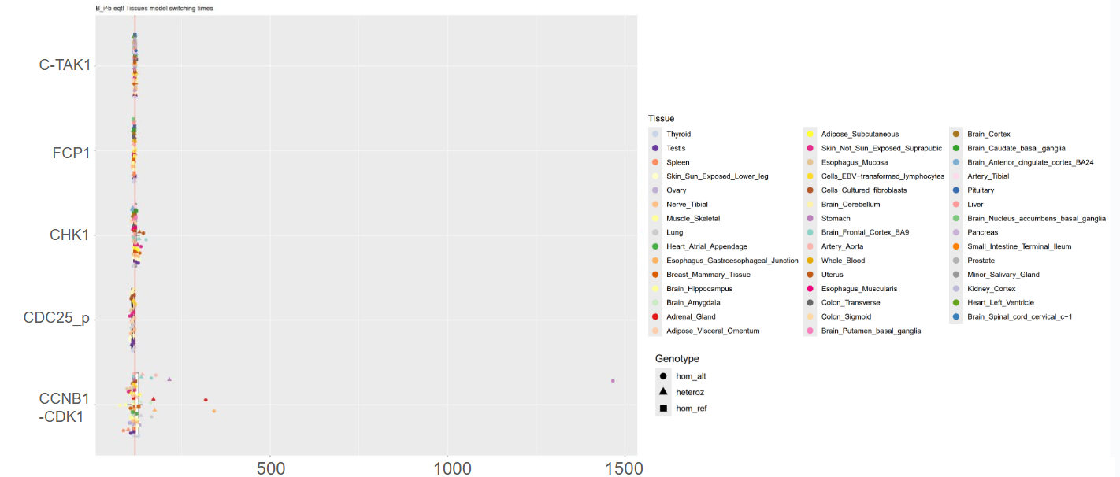
eQTLs
B_{I}^{B}
Notes:
‭Respect to what observed for the previous model, in the context of the model with the inhibitor periodically transcribed, and constant activator, it is possible to observe that no significant variation is depicted. Indeed, only a few tissues are present some delay.
________________
This‬ part of the study wanted to ‭examined‬ ‭the‬ ‭impact‬ ‭of‬ ‭eQTLs‬ ‭on‬ ‬‭gene that takes part in ‭cell ‬‭cycle ‬‭expression,‬‭specifically ‬‭in ‬‭heterozygous‬ ‭and‬ ‭homozygous‬ ‭alternative‬ ‭genotypes‬ ‭across‬ ‭various‬ ‭tissues,‬ ‭to‬ ‭determine‬ ‭if‬ ‭significant‬ ‭fluctuations‬ ‭occur.‬ -> explain about the scaling
‭Analysis‬‭ reveals ‬‭that ‬‭the‬ ‭impact‬‭ of ‬‭eQTLs‬ ‭on‬ ‭certain ‬‭genes ‬‭does‬ ‭not ‬‭consistently ‬‭induce‬ ‭cell ‬‭cycle ‬‭transition ‭switches.‬ ‭Specifically,‬ ‭WEE1,‬ ‭C-TAK1,‬ ‭CHK1,‬ ‭CDK1,‬ ‭and‬ ‭CCNB1‬ ‭exhibit‬ ‭tissues‬ ‭where‬ presence of ‭eQTLs that impact genes encoding for this proteins can even lead to blockage of cell cycle transition where other on the other hand can make it quicker based on how is impacted the expression of eQTLs.
In plot is only show the average switch time per genotype, even though there is difference in the magnitude of the impact of this eQTLs, especially because on the nature of the two model (go and stop system). fluctuations ‬‭related ‬‭to ‬‭CHK1‬
,‭C-TAK1 anc ccnb1. The first two eqtls the presence of a Eqtls on allese tends to be an overexpression of the genes econdig for the two kinases that lead to a delay in the switch time, where as fo CCNB1 an overepxresion of this case lead to quicker transition. By a research on Clinvar no association with any types of disease was found related to these snps , howvere it could be useful to observe if individuals with these type of eQTLs coulb be more or less prone of disease like cancer that present dysregualtion of cell cycle ‬ ‭
estratto da gtex e da dati disponilibli tramite fformulazione matetmatica siamo risucit a ricavare espressione allelica dallel info gterx grande ocllezione eqtls, per ogni eqtls descitto i range entro quid espressione del gene osservabile nella popolazione.
una volta visto questo abbiamo visto
slide in piu tutti tessuti
dare messaggio -> varaizioni modello in presenza eqtl -> anche modello specifico ci sono varaizioni, sottolainaando l’importanza da tenre conto nelal cosktruzione -> possono essre improtanti hanno impatto nel modello

Slide 17
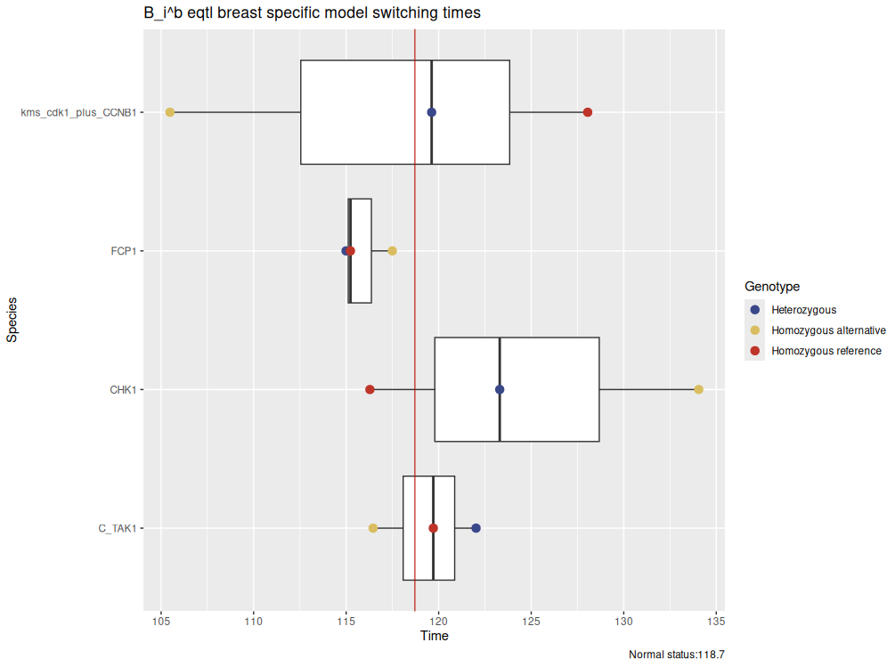
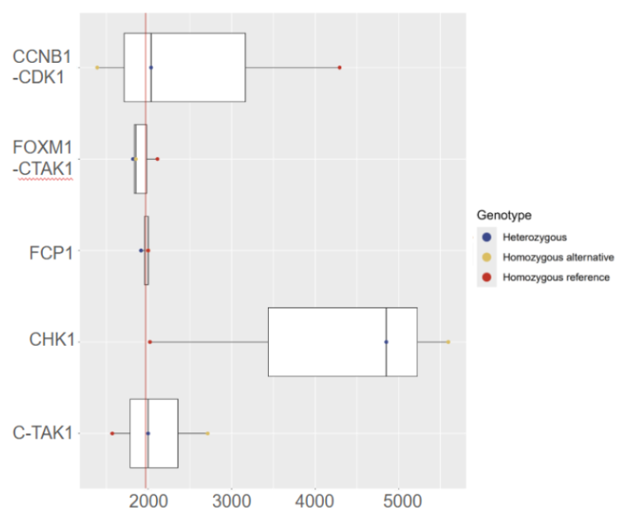
eQTLs
B_{A}^{B}
B_{I}^{B}
Notes:
‭By focusing specifically on breast mammary tissue, the observed behaviour is confirmed. The take home is that eQTLs are indeed able to change the model dynamics. This highlight the importance of considering and integrate eQTLs in cell cycle transition models.
__________________________________________________
This‬ part of the study wanted to ‭examined‬ ‭the‬ ‭impact‬ ‭of‬ ‭eQTLs‬ ‭on‬ ‬‭gene that takes part in ‭cell ‬‭cycle ‬‭expression,‬‭specifically ‬‭in ‬‭heterozygous‬ ‭and‬ ‭homozygous‬ ‭alternative‬ ‭genotypes‬ ‭across‬ ‭various‬ ‭tissues,‬ ‭to‬ ‭determine‬ ‭if‬ ‭significant‬ ‭fluctuations‬ ‭occur.‬ -> explain about the scaling
‭Analysis‬‭ reveals ‬‭that ‬‭the‬ ‭impact‬‭ of ‬‭eQTLs‬ ‭on‬ ‭certain ‬‭genes ‬‭does‬ ‭not ‬‭consistently ‬‭induce‬ ‭cell ‬‭cycle ‬‭transition ‭switches.‬ ‭Specifically,‬ ‭WEE1,‬ ‭C-TAK1,‬ ‭CHK1,‬ ‭CDK1,‬ ‭and‬ ‭CCNB1‬ ‭exhibit‬ ‭tissues‬ ‭where‬ presence of ‭eQTLs that impact genes encoding for this proteins can even lead to blockage of cell cycle transition where other on the other hand can make it quicker based on how is impacted the expression of eQTLs.
In plot is only show the average switch time per genotype, even though there is difference in the magnitude of the impact of this eQTLs, especially because on the nature of the two model (go and stop system). fluctuations ‬‭related ‬‭to ‬‭CHK1‬
,‭C-TAK1 anc ccnb1. The first two eqtls the presence of a Eqtls on allese tends to be an overexpression of the genes econdig for the two kinases that lead to a delay in the switch time, where as fo CCNB1 an overepxresion of this case lead to quicker transition. By a research on Clinvar no association with any types of disease was found related to these snps , howvere it could be useful to observe if individuals with these type of eQTLs coulb be more or less prone of disease like cancer that present dysregualtion of cell cycle ‬ ‭
estratto da gtex e da dati disponilibli tramite fformulazione matetmatica siamo risucit a ricavare espressione allelica dallel info gterx grande ocllezione eqtls, per ogni eqtls descitto i range entro quid espressione del gene osservabile nella popolazione.
una volta visto questo abbiamo visto
slide in piu tutti tessuti
dare messaggio -> varaizioni modello in presenza eqtl -> anche modello specifico ci sono varaizioni, sottolainaando l’importanza da tenre conto nelal cosktruzione -> possono essre improtanti hanno impatto nel modello

Slide 18
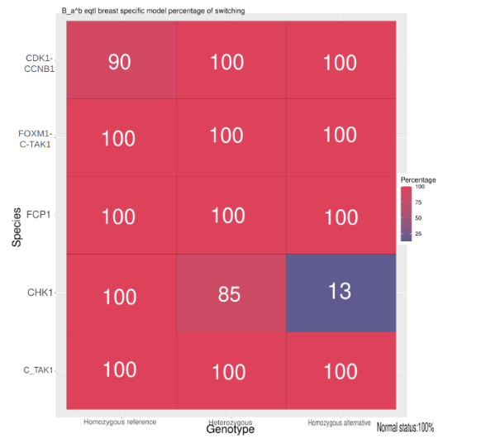
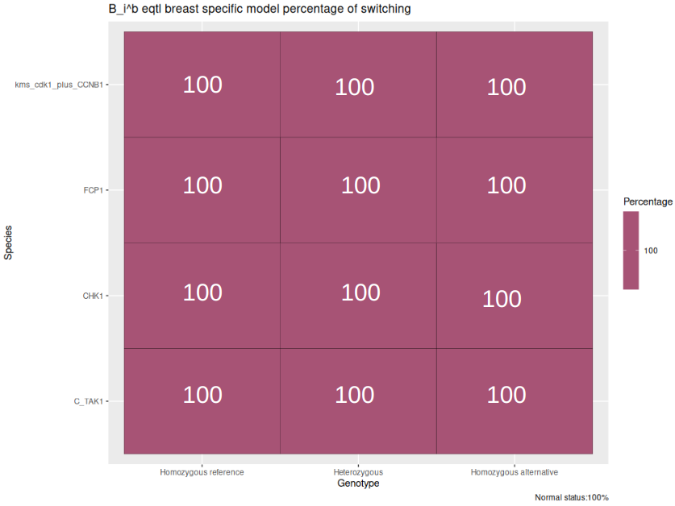
eQTLs
B_{A}^{B}
B_{I}^{B}

Slide 19
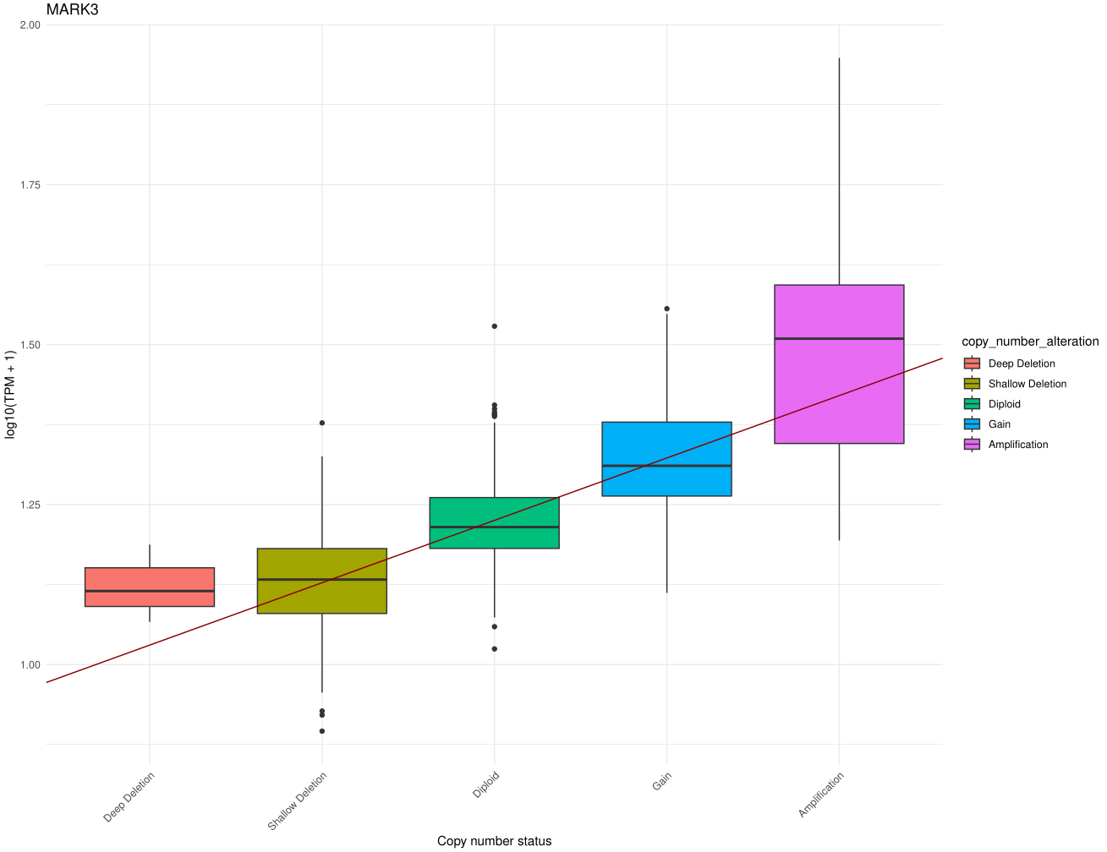

SCNAs
Invasive Breast Carcinoma (TCGA, PanCancer Atlas)
batch-corrected RNA-seq data
somatic copy number alterations data
Notes:
Given the results from the eQTLs analysis, we decided to explore the role of somatic variants in model variations.
SCNAs data were retrieved from the INvasive breast carcinoma dataset, available on TCGA and chosen given tits availability, extensive information on numerous patients, and inclusion of somatic copy number alteration (SCNA) data.
A first step of linear regression analysis was performed to evaluate the correlation between SCNAs and gene expression levels. Only for the selected genes for which a correlation was highlighted, somatic copy number alterations data were integrated into the human G2/M model. This performed to assess the effect of these alterations on fluctuations in average switch time and switch percentage, as performed for eQTLs. Indeed, the goal is to observe possible model changes in dynamic caused by SCNA integration.
______________
The‬ ‭Invasive ‬‭Breast‬ ‭Carcinoma‬‭(TCGA,‬‭PanCancer‬‭Atlas) ‬‭dataset ‬‭was‬‭ selected ‬‭as ‬‭a ‬‭reference ‬‭to ‬‭extract ‬‭gene‬ ‭expression‬ ‬‭breast‬‭ cancer ‬‭patients‬‭(BRCA) ‬‭from a total of 1080 patients from which we had the expression levels for only 983 patients we had SCNAs annotations available. This ‬‭dataset ‬‭was‬ ‭selected‬ ‭based‬‭ on‬ ‭several‬ ‭factors: ‬‭the‬‭ clinical ‬‭relevance ‬‭of ‬‭breast ‬‭cancer, ‬‭the‬‭ high ‬‭availability ‬‭of ‬‭data,‬‭and‬ ‭its ‬‭representativeness‬ ‭of ‬‭the‬ various breast subtypes.‬
‭The‬ ‭Adult‬ ‭Genotype-Tissue‬ ‭Expression‬ ‭(GTEx)‬ ‭project‬ ‭(‬‭https://gtexportal.org/home‬‭),‬ ‭a‬ ‭publicly‬ ‭available‬ ‭resource,‬ ‭was‬ ‭utilized‬ ‭to‬ ‭extract‬ ‭eQTLs‬ ‭information, extract‬ ‭median‬ ‭gene-levels‬ ‭in‬ ‭TPM‬ ‭for‬ ‭each‬ ‭tissue. and informations of each gene of interest involved in cell cycle g2/m transition

Slide 20
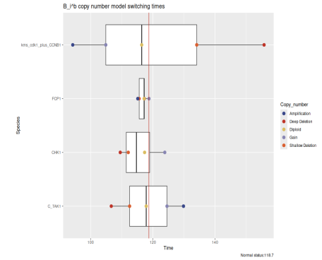
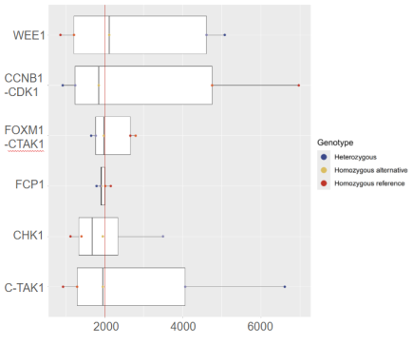
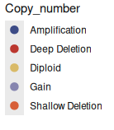

SCNAs
B_{A}^{B}
B_{I}^{B}
Notes:
As seen in part for eQTLs, cdk1, C-tak1 and CHK1 were the ones that presented more fluctuation in both models, even thoug with different magnitudo. It is possible to observe that increased quantity of chk1 and ctak1 lead to a delays in the cell cycle. The opposite is observed for CDK1, where amplifications lead to a quicker switch and therefore transition.
As observed for eQTLs, some species are more sensible to variations than others.
____________________________________________________________
→ varianti somatiche presenti nei tumor, dati che avavemao -> costruito modlli che ahno trascrizone gene in -> per ogni gene modello specifico -> esporarle spazio dinamica modello si muove -> parte regressione senza descriver il dettagloio , moedllo legasse a una range valori ti aspeti che rifeltta la varaitne -> alcuno paarmetri piu sensibili di altri

Slide 21
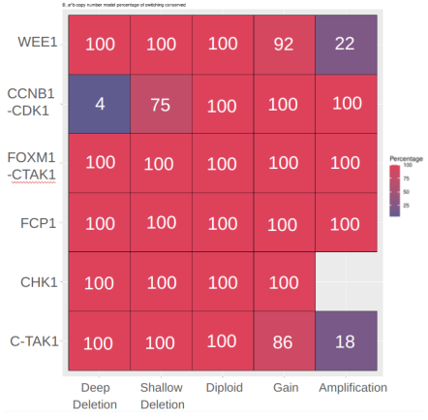
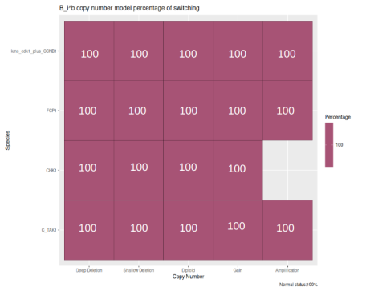
SCNA
B_{A}^{B}
B_{I}^{B}

Slide 22
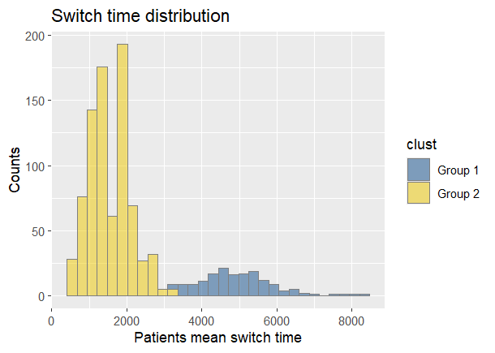
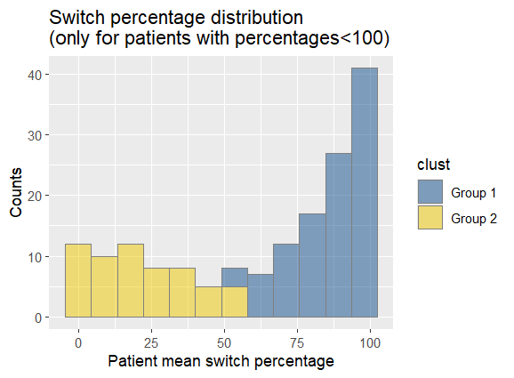
Patient stratification
threshold = 3290
threshold = 55%
Notes:
As previously mentioned, SCNAs are able to impact the dynamic of the models. Given this information, the next step was understanding if it is possible to extend this analysis to patient-specific models.
As result, Patient-specific cell cycle transition models were generated by integrating breast cancer somatic copy number information, these models were simulated a hundred times each, etractring the average switch time and switch percentage. The goal of this step is to utilize the model's dynamic behavior to characterize patients. The B_A^B model was selected for this analysis. By looking at the switch time distribution and switch percentage distribution it is possible to observe that a the data follow a bimodal distribution, suggesting the presence of two distinct groups. This was confirmed through the utilization of k-mean clustering from which it was also possible to retrieve the thresholds that separate the two groups.
___________________
with the information retrieve from the data of invasive breat cancer annotated with copy numebr status it was possible to adapt the G2/M human transition cell cycle model to patients specific. was take into consideration only B_{A}^{B} because due to improitnace of G2/M transition in cell cycle in human and the fact that regulating‬ ‭mitosis‬ ‭entry,‬ ‭the ‬‭prevalence‬‭ of‬‭ aberrant‬ ‭mitosis ‬‭in ‬‭cancer well established and from the findings in romanel et al where STOP regulation system usually is related to important transition for cell.
-> focalizzato su un modello e
looking both at the switch time distribution and switch percentage distribution it is possible to observe that follow a bimodal suggestion two groups, this was confirmed thoug the utilization of k-mean clustering from whihc it was also possible to retrieve the thresholds that seopare the two groups. Notable by looking at the frequencies of somatic copy number aberrations it was possible to observe notable differences between the two, for CDK1 mainly for shallow deletion and wee1 mainly for gain.
considerando per ogni profilo copy number di ongi pazientie passo successivo ocnstruzioen modlli specifici ridpiducendo dimanica modello paziente specifico e esporlare info paziente specifiche e osservare
-> infomarizoni su survival dei pazieiti e si èe svolt oqueste analisi , due vavilibli di interesse (%e switch ) -> paralre 100 simulazoni -> domandadti con infoamrizoni di survival se pazienti socn siwthc e % grouppo piu o meno suvival dell’altro

Slide 23
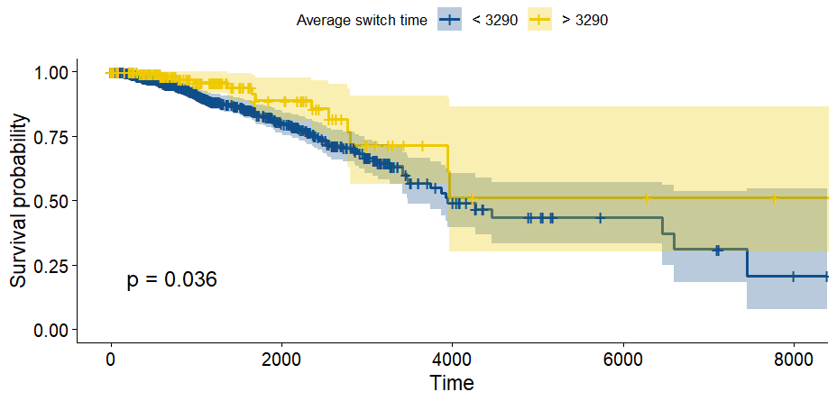
Survival Analysis (OS)
Notes:
Since informations on overall survival for each patient of each group was available, the next question was to understand if evident differences in survival among the groups was present.
Indeed, regarding the survival analysis on the switch time, it is possible to observe that ‭patients‬ ‭with‬ ‭mean‬ ‭switch ‬‭times‬‭ greater‬‭ than‬‭ 3290, ‭suggesting‬ ‭slower‬ ‭cell‬ ‭cycle‬ ‭progression ,present higher survival probability.

Slide 24
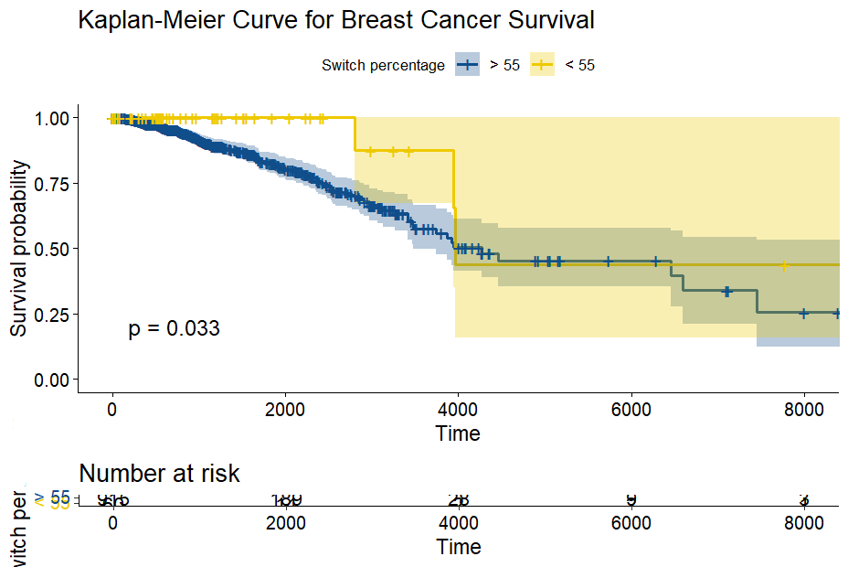
Survival Analysis (OS)
Notes:
Similar results were observed for patients with switch percentages lower than 55 .‬ ‭The‬ ‭switch‬ ‭percentage‬ ‭reflects‬ ‭the‬ ‭number‬‭ of ‬ times, ‬‭out‬‭ of ‬‭100, ‬‭that ‬‭the‬‭ G2/M‬ transition‬ ‭was‬ ‭observed.‬
For both the average switch time and switch percentage, the analysis on overall survival suggests that a slower cell cycle transition, is linked with an overall higher survival probability.

Slide 25
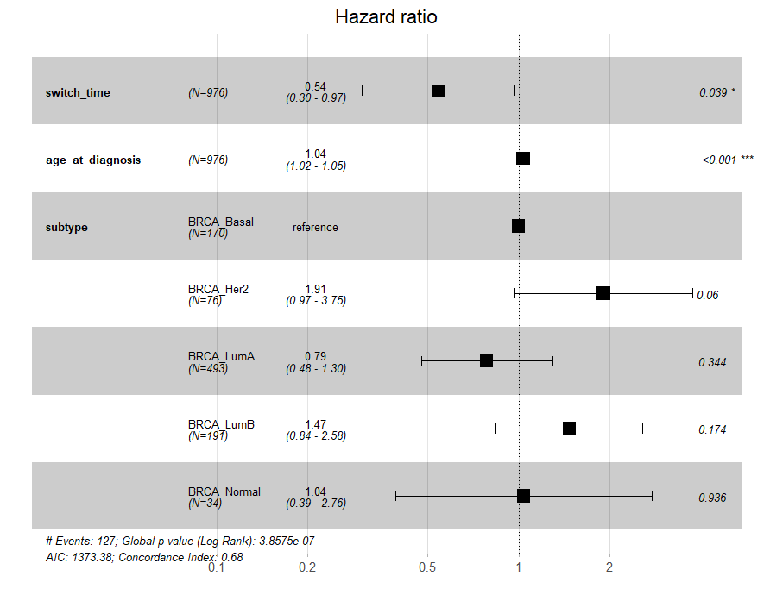
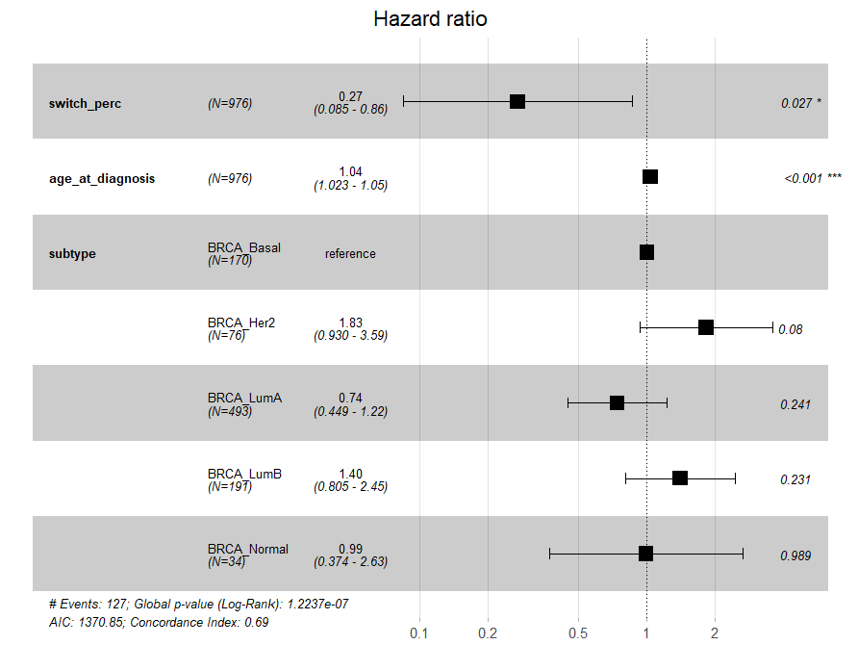
Survival Analysis
Notes:
SInce the overall survival is impacted by other variables like age and subtyoe, the analysis was corrected using a mulivariate cox regression, deriving the hazard ratio. This ratio is used to determine the risk of death of patients. Switch time and switch percentage were found to be, once again, statistically significant in this analysis. Specifically, the group of patients associated with mean switch time > 3290 have a lower risk of death (and therefore a higher survival rate) than the group of patients associated with mean switch time < 3290. Specifically, having a higher switch time reduces the hazard by 46%. Similarly, being part of the group with switch percentage < 55 exhibits a lower risk of death, indeed, the hazard is reduced by 73%. (NB. Hazard = death!).

Slide 26
Conclusions
Sensitivity analysis
Insight applying stochastic model to represent cell cycle transition
Integrating mutation information when developing model
Mathematical model used describe impact mutation at patient level
Survival analysis
Characterization of a generic cell cycle transition model
Human cell cycle G2/M transition
eQTLs and SCNAs integration
Notes:
The ‬‭study ‬‭provide ‬‭valuable ‬‭insight‬ ‭into ‬‭applying ‬‭a ‬‭stochastic ‬‭model‬‭ to ‬‭represent ‬‭and ‬‭investigate ‬‭cell ‬‭cycle‬ ‭transition,‬ ‭and‬ ‭the‬ ‭influence‬ ‭of‬ ‭germline‬ ‭and‬ ‭somatic‬ ‭mutation‬ ‭information.‬ ‭The‬ ‭results‬ ‭underscore‬ ‭the‬ ‭importance‬ ‭of‬ ‭integrating‬ ‭this‬‭ knowledge ‬‭when ‬‭developing‬ ‭mathematical ‬‭models.‬‭ Moreover,‬ ‭the‬ survival ‭analysis‬ ‭results‬ ‭indicate‬ ‭that‬ ‭mathematical‬ ‭models‬ could ‭be‬ ‭used‬ ‭to‬ ‭describe‬ ‭the‬ ‭impact‬ ‭of‬ ‭mutations‬ ‭at‬‭ the‬ ‭patient‬ ‭level.‬ ‭

Slide 27
Future Perspectives
Increase the number of patients considered
subtype-specific survival analysis
G1/S and M/G1 checkpoints
Integrating eQTL and SCNA together (also other variants)
Extending this approach to other tumor types
Refinement and expansion of general cell cycle transition models

Slide 28
Thank you

